Slide 1
WHY CLASSICS?

Slide 2


Slide 3
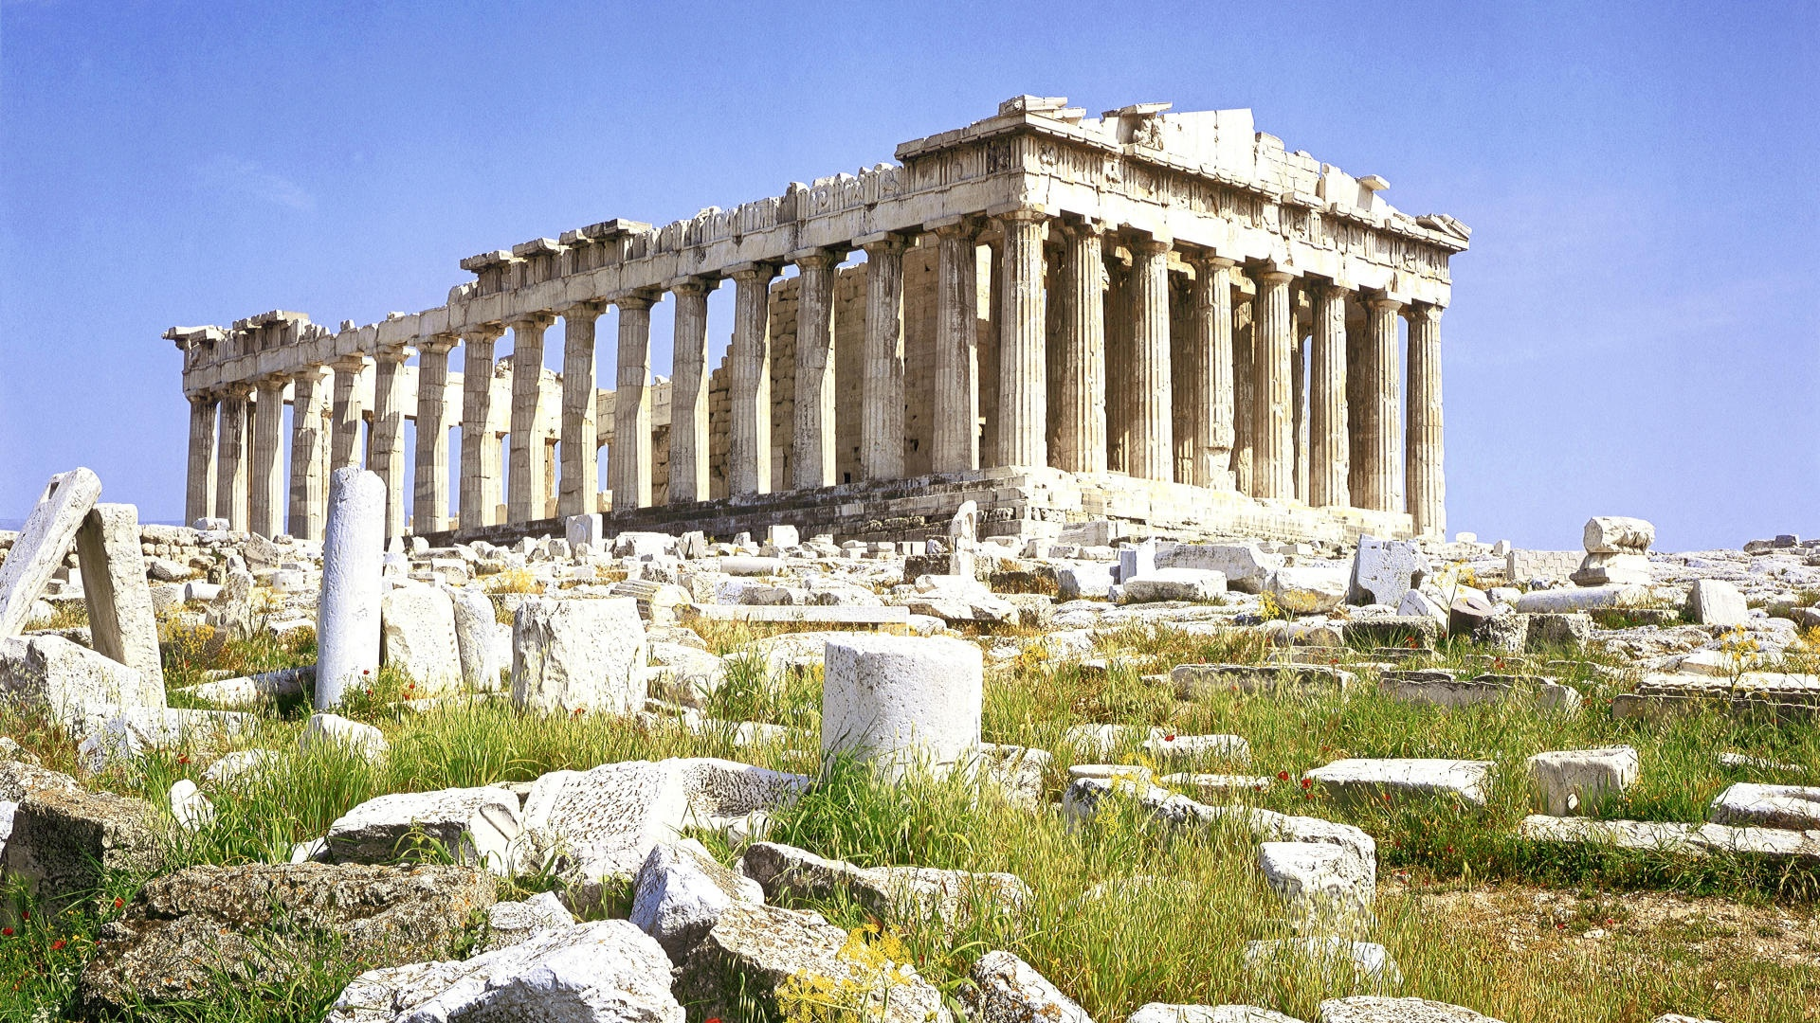

Slide 4
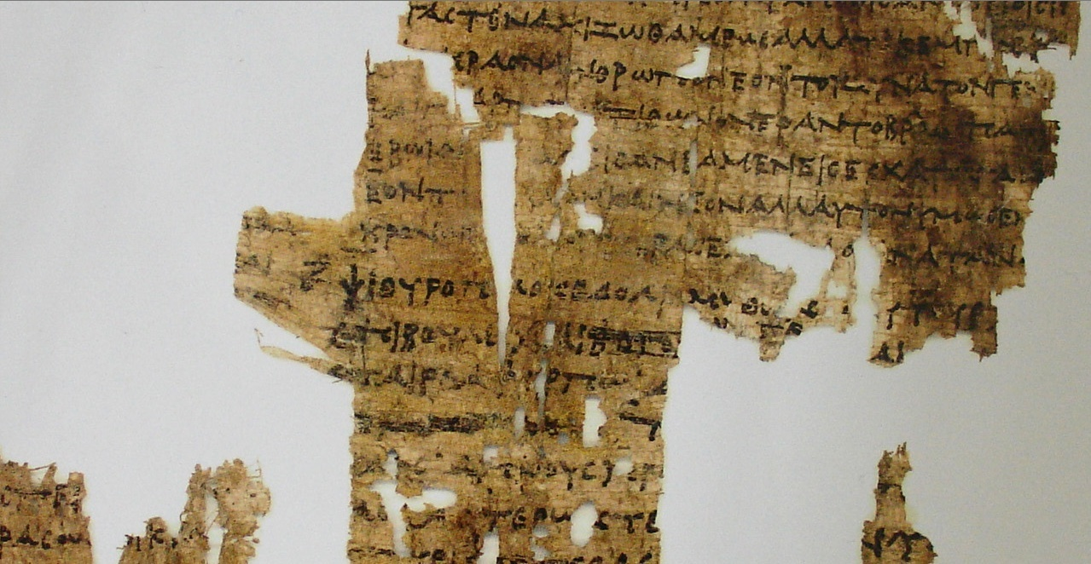

Slide 5
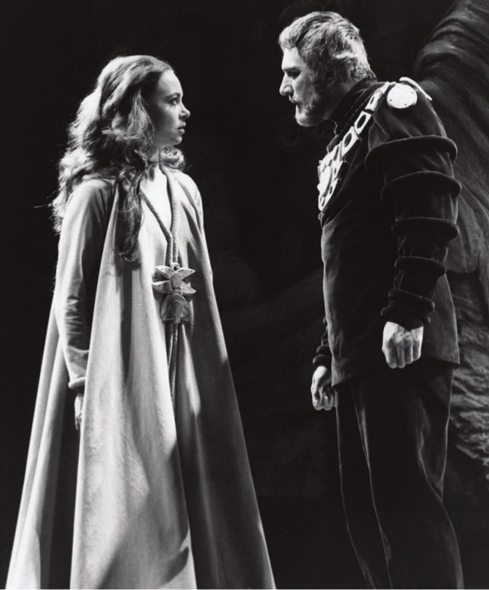

Slide 6


Slide 7
It was not Zeus who issued that order of yours, and it was not Justice, the companion of the gods below, that defined laws like this among mortals; and I did not think your orders were strong enough to outmatch, mortal as you are, the unwritten and secure laws of the gods. They live not for today or yesterday, but for ever, and nobody knows their origin.
Sophocles, Antigone 450-7

Slide 8


Slide 9
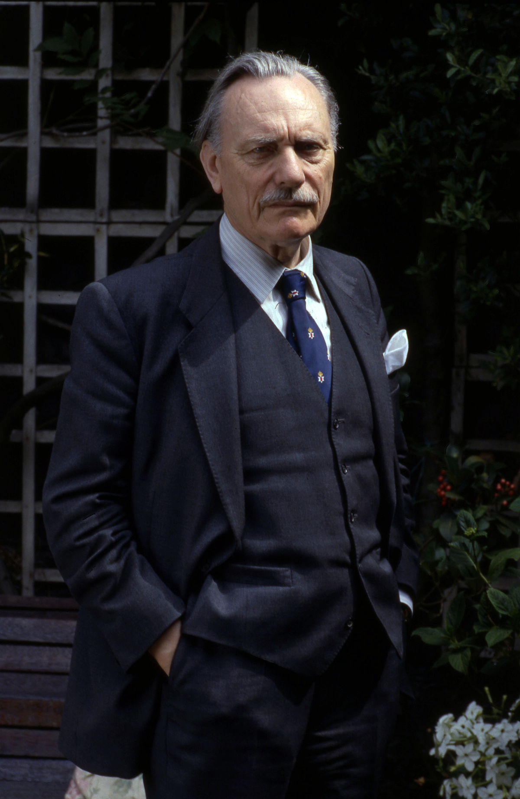

Slide 10
As I look ahead, I am filled with foreboding; like the Roman, I seem to see the River Tiber foaming with much blood.

Slide 11
You will be a suppliant begging in dire need among all the peoples and all the cities of Italy. Once again the cause of all your suffering will be a foreign bride, another marriage with a stranger. But do not give way to these adversities: face them all the more boldly, go where your fortune allows. The first path to safety is what you least expect: it will start from a Greek city.
Virgil, Aeneid 6. 91-7

